Slide 2

Cro-Fu
FusionFabric CrowdFunding Platform
Paris Hackathon ‘15

Slide 3
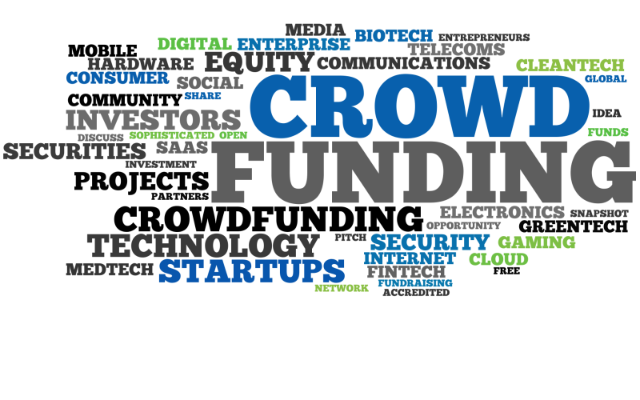
What is CrowdFunding?
Funding of Projects by Individuals
Online Platform
4 Major Categories
  Donation (Charity, …)
  Reward based
  Equity based
  Debt based (CrowdLending, P2PL)
© Misys 2015

Slide 4

CrowdFunding Market
>1Million projects
$34bn in yearly transactions
  $1tn target in 2020
>1300 active platforms
Banks scratching the surface
© Misys 2015
Notes:
Source crowdsourcing.org
http://www.crowdsourcing.org/editorial/global-crowdfunding-market-to-reach-344b-in-2015-predicts-massolutions-2015cf-industry-report/45376

Slide 5


Hackathon Project
CrowdFunding Platform running built w/ Fusion Fabric
PoC FusionReactor Gate 3 project
Running in Cargo
Scalable
SaaS or Entreprise
Show Basic Project Flow
© Misys 2015

Slide 6
Introduction ~1min
What is Crowd Funding
Crowd Funding Market
What is Fusion Crowd Funding?
Architecture: Entreprise or SaaS
Demo Architecture
  Cargo connecting to external subsystems
  Users
© Misys 2015

Slide 7

Demo ~3min
Show Cargo running in its shell => Fusion Goodness
Open Browser on home page => Describe QuickStart
Log in as PO
Go to My Projects => Describe
Start New Project => Create a new Project Named “Solar Panels”
Review => Describe
Go to Projects List => Describe
Log in as Shifu on second Browser, keep first one
Go to My Project => See it’s empty
Go to Project List, Select “Solar Panels” => Goes to Project Description
Click on Donate => Form Show up
Make contribution => Show Progress in Project (both pages)
Show Investment in “My Projects”
© Misys 2015

Slide 8
Conclusion ~30s
Market is Ripe for this Solution
Misys is ideally Positioned
    Technology
    Client Base
    Culture
Believe in this!
© Misys 2015

Slide 9
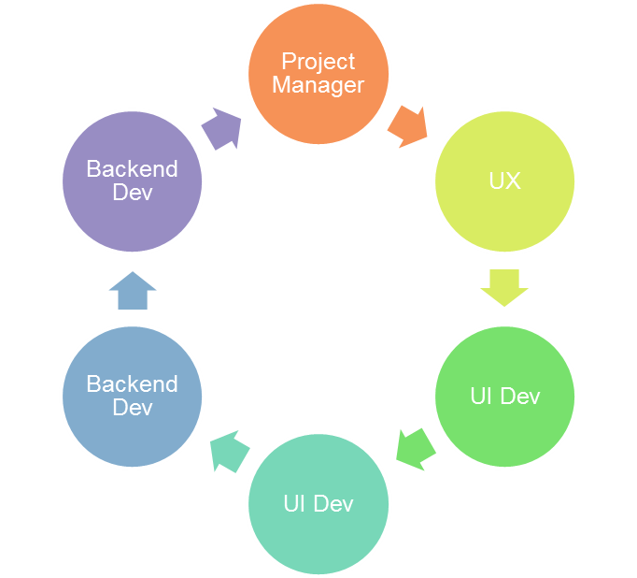

Dream Team
© Misys 2015

Slide 10
JC Jollant
Development Group Manager

